Slide 1
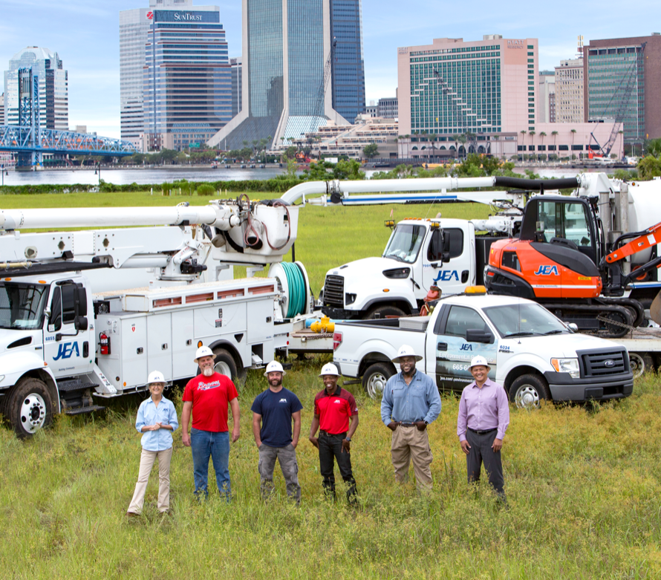


Contractor Safety Management Process:
JEA Safety Orientation
January 2023

Slide 2
JEA Safety Orientation (JEASO)
What you need to know about JEA and what is expected of each Contractor:
Safety Briefing
About JEA
Expectations and Safety Goals
Job Safety Briefs
Contractor Responsibilities
Safety Briefing – every job starts with one

Slide 3
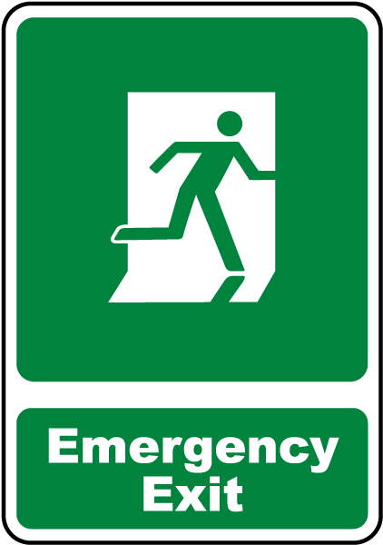
JEASO
Emergency Notifications
Evacuation Routes
Check surroundings/tasks for hazards - and ways to control them
Maintain Situational Awareness
Be Prepared!!!
Safety Briefing – every job starts with one

Slide 4
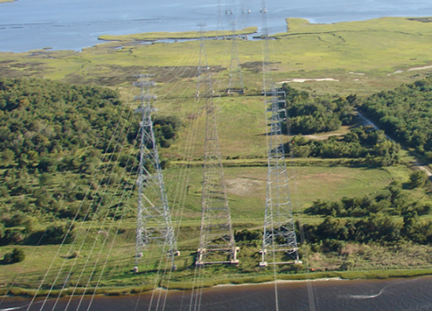
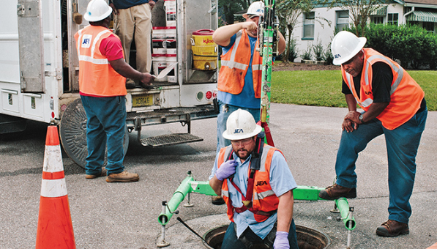
JEASO
Welcome to JEA
JEA serves over 1.1 million electric, waster, sewer, and reclaimed water customers
We are community owned, not investor owned, so we are a not-for-profit utility
We have over 7000 miles of electric lines and over 8500 miles of water and sewer lines
None of that happens without you, our contractor community!
About JEA

Slide 5

JEASO
Safety Vision: JEA embraces a Zero Incidents vision where preventative safety is a way of life both on and off the job.
Safety Mission: JEA is committed to providing utility services in a manner that will ensure the safety of our employees, contractors, customers, and communities we serve.
Plan for Zero Video – 3 min
Safety Goals

Slide 6

JEASO
We expect you to:
Know and comply with the JEA’s Contractor Safety Management Process.
Know your company’s safety requirements.
Know and comply with the Safety Regulations that pertain to the tasks and work functions you are performing.
Know and comply with any specific safety requirements in Contract.
Speak up and stop processes that are dangerous. Do not assume your supervisor is aware of a hazardous condition or situation.
Report injuries, environmental releases, property damage, and near misses.
Utilize industry best practices.
Know who your JEA Contractor Sponsor is.
Work directly with your Supervisor, JEA Contractor Sponsor, and Safety & Health Services to ensure a safe working environment for you and those around you.
Expectations

Slide 7
JEASO
We expect your company to:
Follow your organization safety requirements
Provide a Safe Working Environment
Comply with the JEA Contractor Safety Management Process (CSMP)
Utilize industry best practices
Comply with the Safety Regulations
Refer to and follow JEA’s Contractor Safety Management Process and your contract to the extent they may be more stringent than the above with regards to safety
Work directly with your Contractor Sponsor and JEA Safety & Health Services
Resources:
Consult your staff EHS professional
Safety councils, ASSP, NUCA, ABC
View OSHA’s webpage
Click here to view the JEA CSMP
Contact your Contractor Sponsor or email safety@jea.com for general safety related questions
Expectations

Slide 8
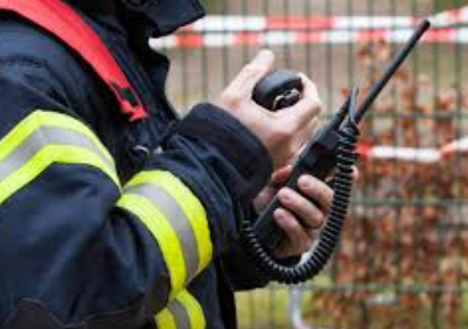
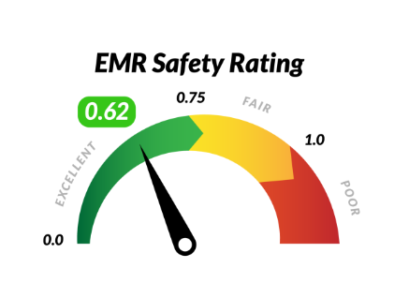

JEASO
Meet the expectations on the previous slide
Contact your contract sponsor to ensure you get site specific safety information for your work location as it may:
be unique to the facility/area in terms of alarms, evacuations etc.
have different emergency notification information
require additional items – such as badging, duration of hot work monitoring periods, etc.
Your sub-contractor is your responsibility. Ensure that:
They meet EMR the requirement
They comply with substance abuse policy
They comply with all safety requirements on the job
Your responsibilities

Slide 9

JEASO
Remember!
Every employee is responsible for safety
Every job supervisor/leader is responsible and accountable for safety
Every prime contractor is responsible for their sub contractors
Your contract and contract sponsor is your primary resource for your questions regarding your work and job site
JEA Safety and Health Services can answer safety questions either over the phone or after a job site visit. Their contact information is at the end of this presentation. Or they can be reached through your contract sponsor.
Key Takeaways

Slide 10
Safety Contacts
Safety & Health Specialists
S&HS Team Member | Area of Responsibility | Office Location | Cell #
Daniel, Dwayne L. | Overhead (WSC), Substation, System Protection & Controls | WSC | (904) 676-4478
Fisher, James L. | W/WW - Delivery & Collection; Ext Affairs, Tech Services | PSSC | (904) 229-5045
King, Joseph M. | Customer, Human Resources, Logistics, Finance | CWSC | (904) 874-7270
Parker, Roger A. | W/WW - Treatment and Reuse, Energy and Water Planning | Buckman | (904) 349-6108
Vermaelen, Terry | Overhead (SSC), UG, Preventative Maintenance, SOCC | SSC | (904) 874-0003
Warren, Gretchen E. | Electric - Power Production | NGS | (904) 544-1825

